Slide 1

Machine Learning Models
MODELLING PUBLIC HEALTH DATA (MQB7046)
DR MOHAMAD ZULFIKRIE BIN ABAS

Slide 2
Outline
Recap on previous lesson
Hands on – introduction to python
Hands on – building prediction model

Slide 3
Machine learning algorithm
Supervised
Unsupervised
Reinforced
Regression
Classification
Binary
Multiclass
Multilabel

Slide 4
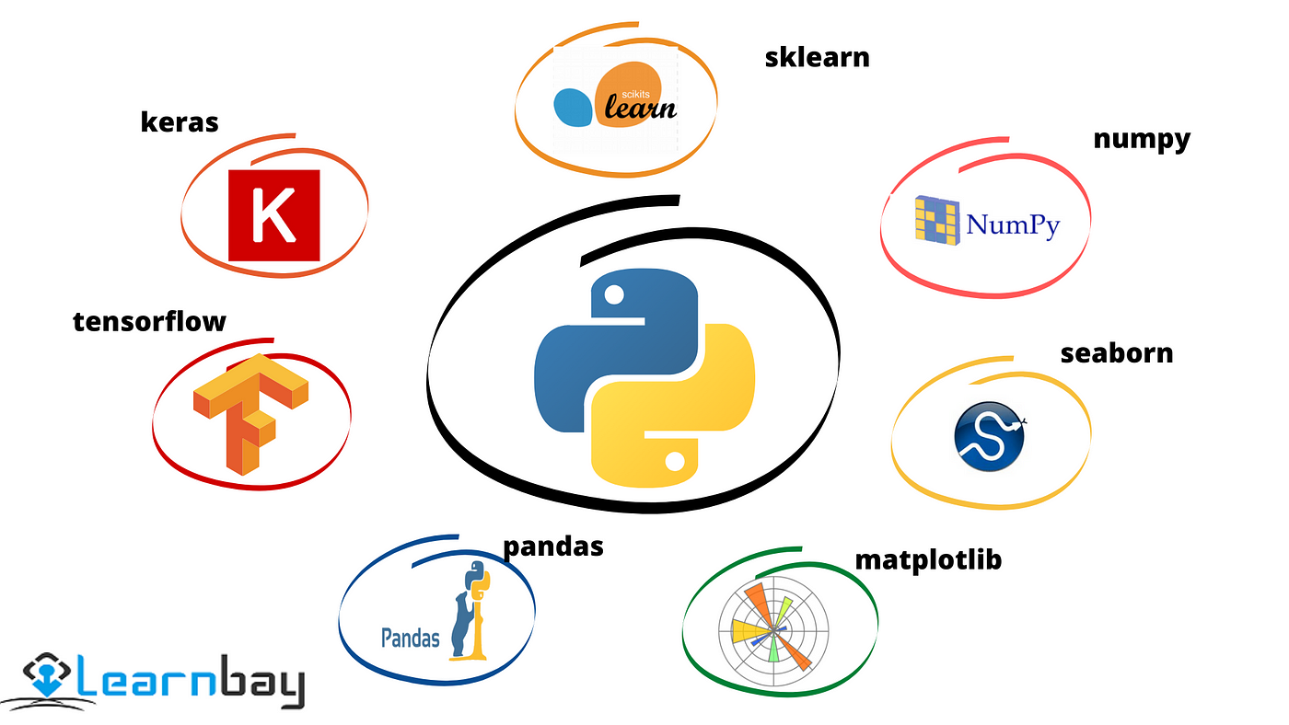

Slide 5
Basic Steps in Model Building
Data Preparation
Data Splitting (Train/Test)
Model Training
Model Evaluation

Slide 6

Hands-on – introduction to python
Download anaconda navigator
https://www.anaconda.com/download
While waiting, we use google colab

Slide 7
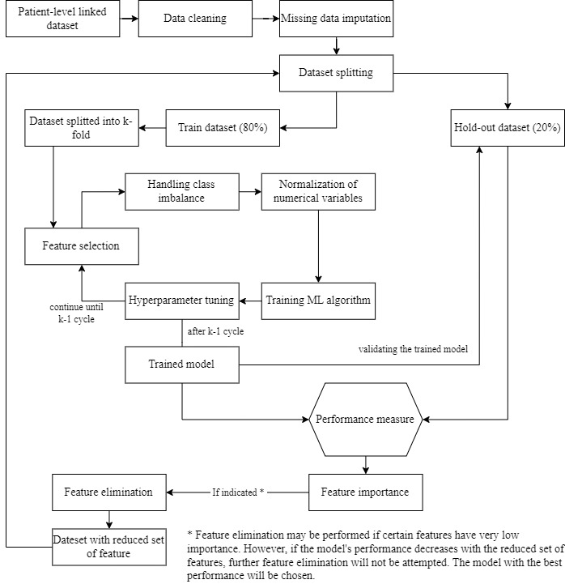
Hands on – building prediction model
Development of Prediction Models
Approach: Use machine learning algorithms
Random forest (RF)
Light gradient boosting machine (LGBM)
Performance Comparison: Using ROC-AUC.

Slide 8
Data preparation
Data splitting
Model training
Model evaluation

Slide 9
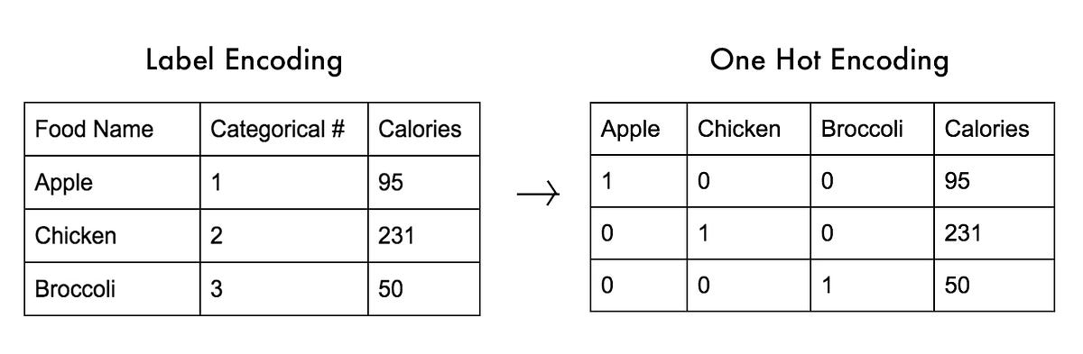
Data cleaning – handling categorical variable
Cannot handle string
Need to be converted
One hot encoder
Label encoder
Manually done in other format such as .csv, .dta etc.

Slide 10
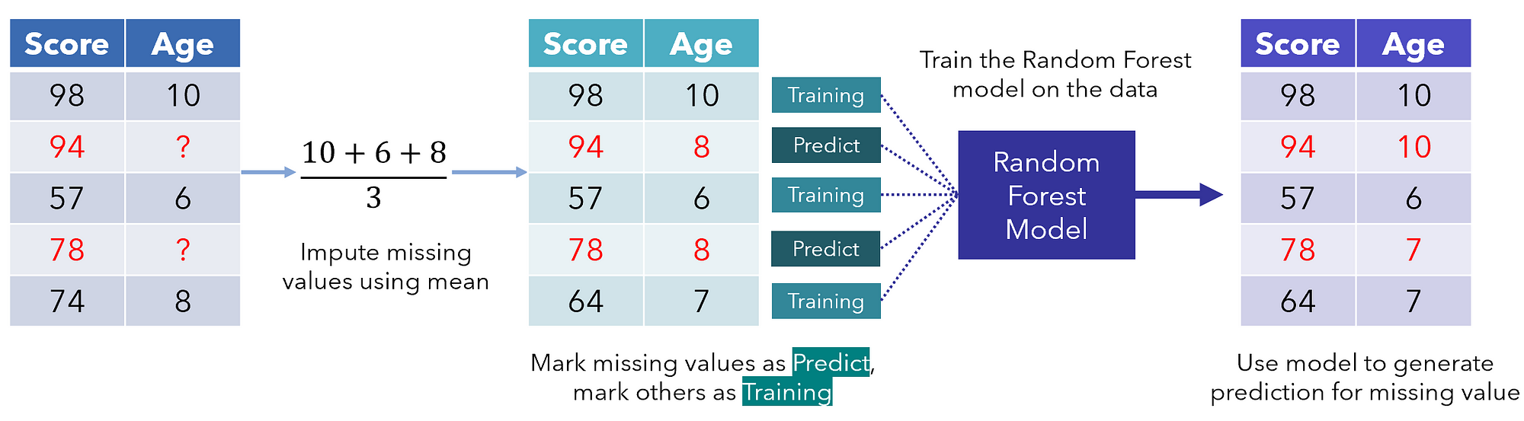
Missing data imputation

Slide 11

https://appurl.io/ig6YaPMHhJ

Slide 12
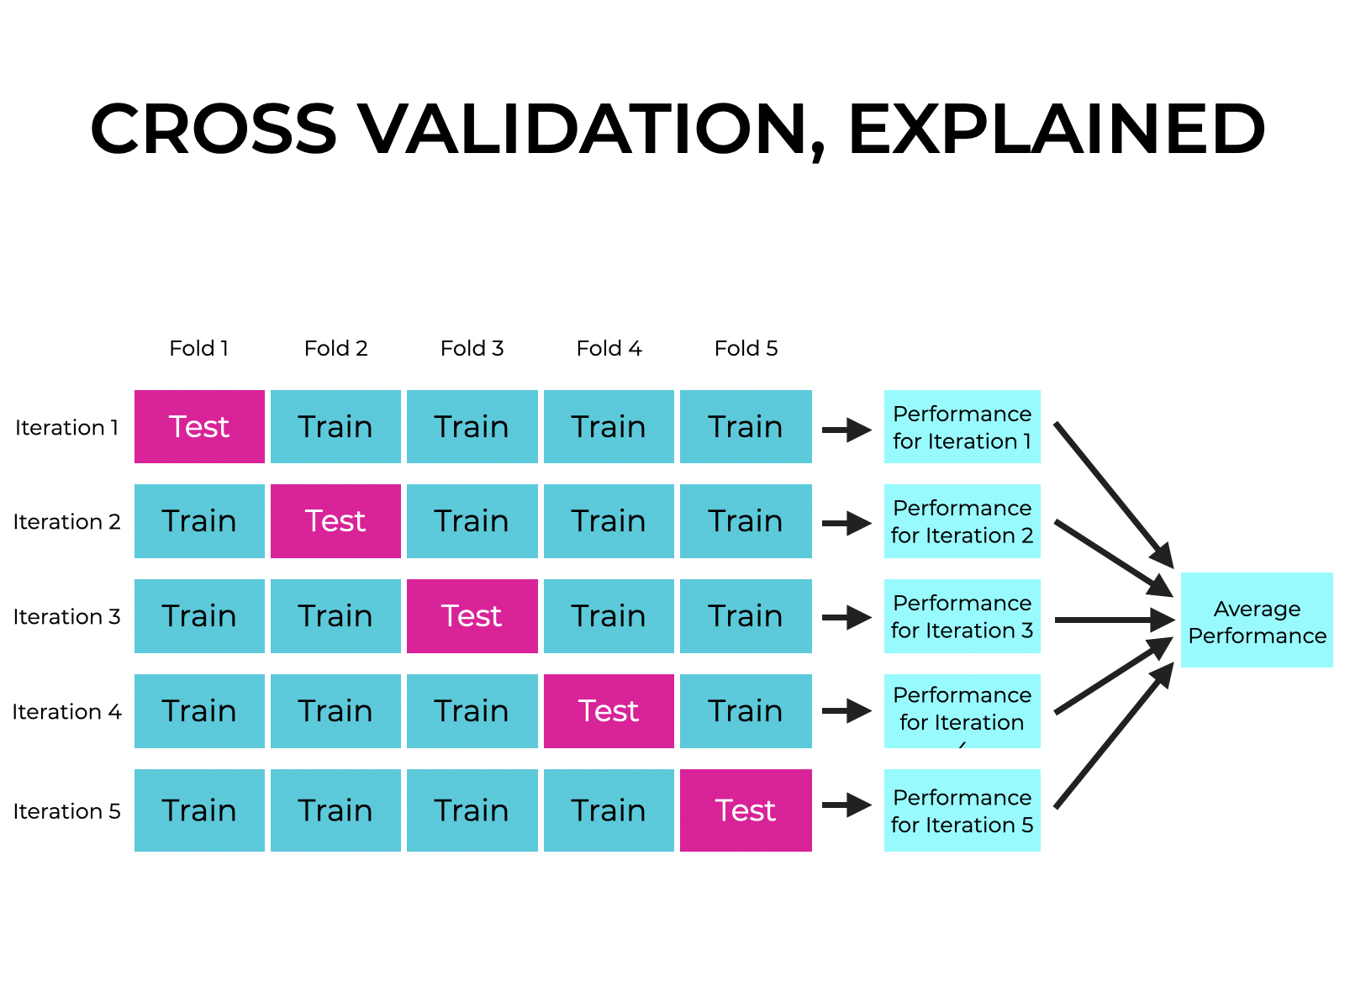
Cross validation

Slide 13
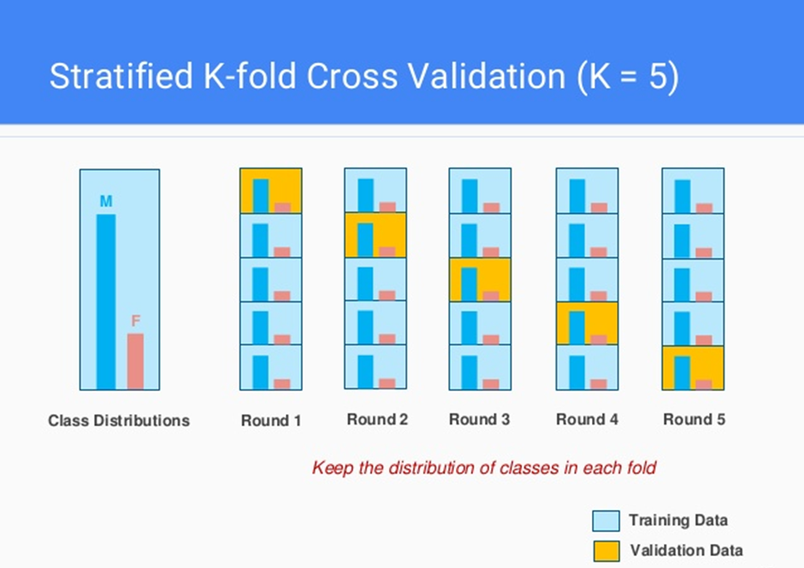

Slide 14
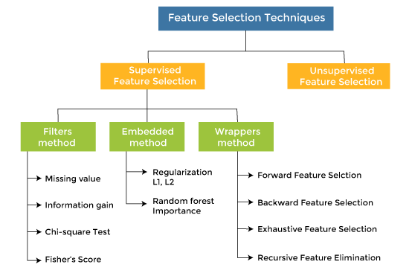

Slide 15
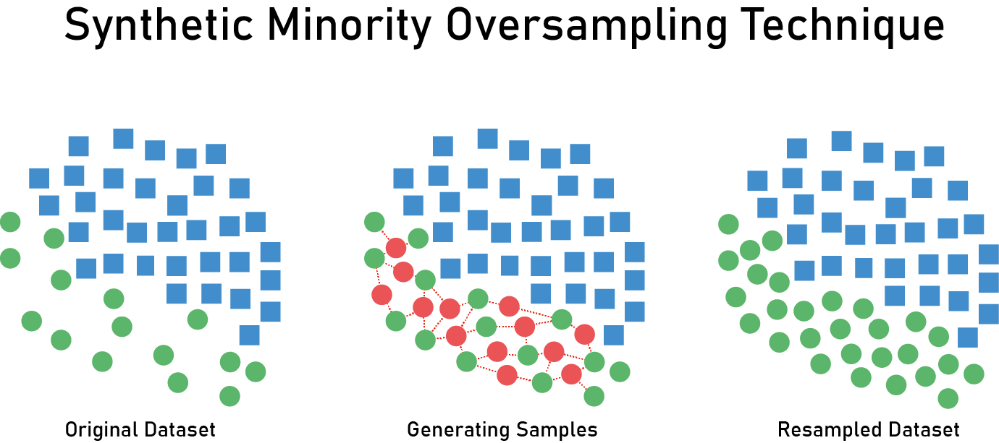
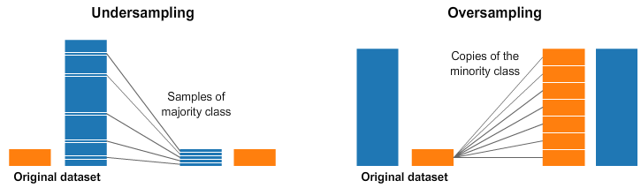
Handling class imbalance

Slide 16
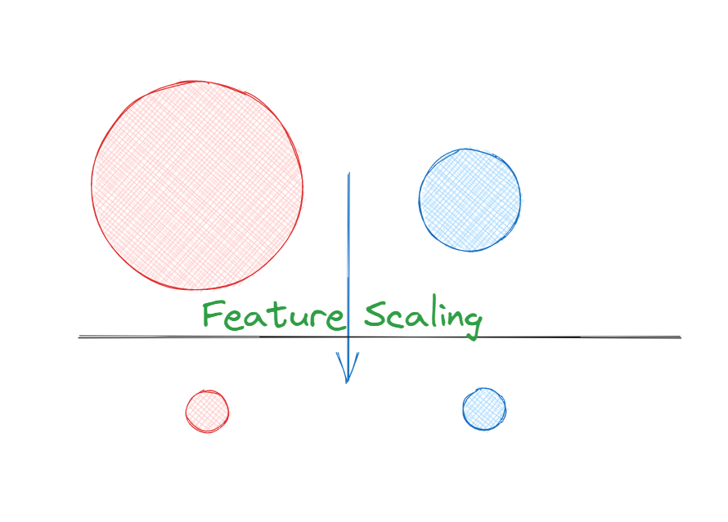
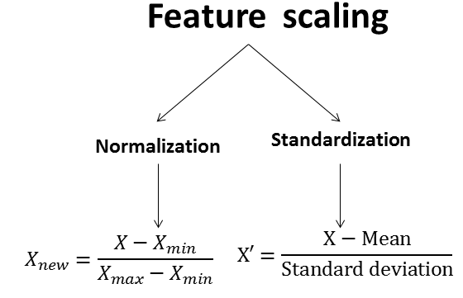

Slide 17
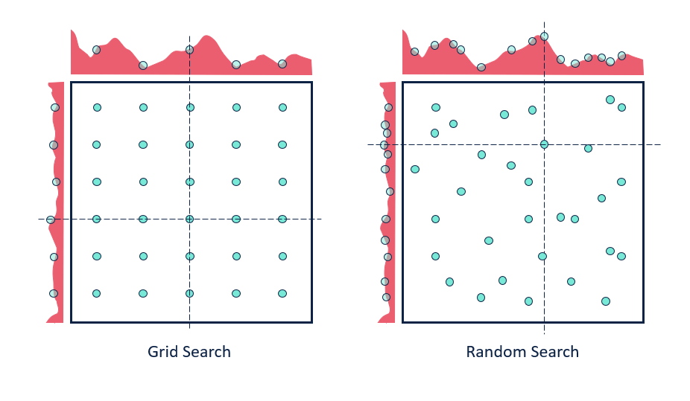
Hyperparameter tuning

Slide 18
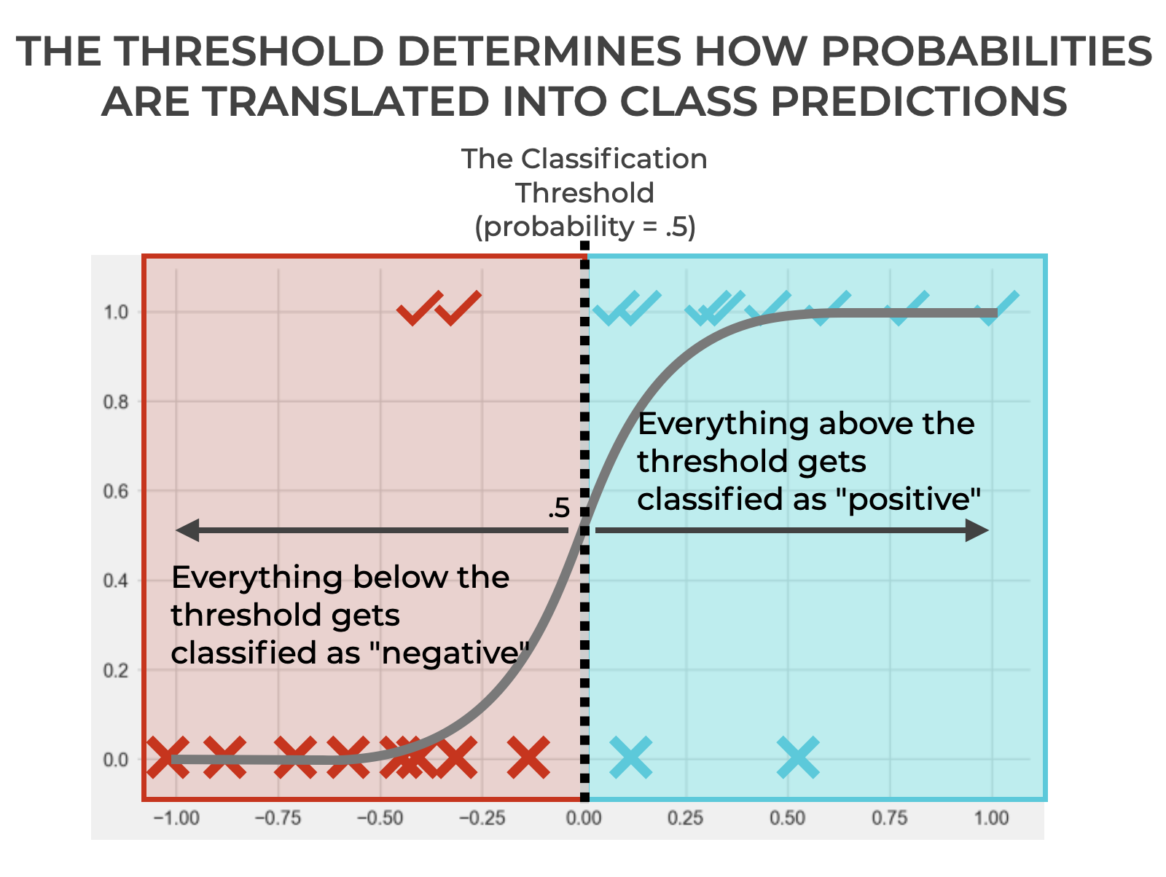

Slide 19
